Slide 1
P08 Train Schedule 6th Presentation
A113 – Mathematics

Slide 2
National Education Message
National Education Message:
“We have confidence in our future.” – United, determined and well-prepared, we have what it takes to build a bright future for ourselves, and to progress together as one nation.
Today, the MRT and buses form an integral part of the public transportation system within Singapore, offering Singaporeans a viable alternative to private transport.
Question:
How does a reliable and efficient public transport system play a part in nation building?

Slide 3
National Education Message
‘Great MRT Debate’
The government embarked on a study in 1967 to develop a long-term solution to a sustainable transport system. Completed in 1971, the study envisaged the need for a rail transit system to cater to Singapore's growing transport needs. Thus began the 'Great MRT Debate'. The decision to build a $5 billion solution did not come easy. After a decade of rigorous discussions, the government gave the MRT the green light in May 1982.

Slide 4
National Education Message
Public transport system is one of the most important part of country’s master plan to provide seamless and synchronous flow involving people, goods from one location to another irrespective of the distance and any other external factor involved.
Public transport system also displays the nation’s strength as how well it provides inter connectivity with other countries in the global map.
It is a key factor for economic growth, adding speed and efficiency to a country’s progress.

Slide 5
Definition of terms
Distance is the total length covered by a moving object independent of the direction of the motion.
Speed is the distance travelled over the time period.
These are scalar quantities. They are always positive.
Speed = Distance (m)
(m/s) Time (s)

Slide 6
Definition of terms
Displacement is the length measured from a reference point to the final position in a specified direction.
Velocity is the rate at which an object changes its position.
Acceleration is the rate of change of velocity.
These are vector quantities.
Velocity = Displacement (m)
(m/s) Time (s)
Acceleration = Change in Velocity (m/s)
(m/s²) Time (s)

Slide 7
Illustration of terms
In this example, if Point A is the reference point and taking right side as positive, then
Position of Point C with reference to Point A = 80 m
Position of Point B with reference to Point A = −40 m
B
A
C
40 m
80 m

Slide 8
Illustration of terms
In this example, if Point A is the reference point and an object travels from Point A to Point C in 8 seconds,
Total distance travelled = 80 m
Displacement (Change in position)
= Final position – Initial position
= 80 – 0 = 80 m
Average Speed = Total distance travelled / Time taken = 10 m/s
Average Velocity = Displacement / Time = 10 m/s
B
A
C
40 m
80 m

Slide 9
Illustration of terms
In this example, if Point A is the reference point and an object travels from Point A to Point B in 4 seconds,
Total distance travelled = 40 m
Displacement = – 40 – 0 = – 40 m
Average Speed = Total distance travelled / Time taken = 10 m/s
Average Velocity = Displacement / Time = −10 m/s
B
A
C
40 m
80 m

Slide 10
Illustration of terms
In this example, if Point A is the reference point, and an object travels from Point B to Point C and reverses back to Point D in 15 seconds,
Total distance travelled = 120 + 30 = 150 m
Displacement = 50 – (– 40) = 90 m
Average Speed = Total distance travelled / Time taken = 10 m/s
Average Velocity = Displacement / Time = 6 m/s
B
A
D
C
40 m
80 m
30 m

Slide 11
Rate of change
The rate of change of a quantity is the change in the quantity with respect to the time lapsed.
The average rate of change of a quantity is the total change in the quantity with respect to the total time lapsed.
The rate of change at a particular instance is known as the instantaneous rate of change, which can vary at different points in time.

Slide 12
Average vs Instantaneous Rate of Change
Average speed describes the distance/time ratio over a period of time.
Instantaneous speed is the speed at any point in time.
Average velocity describes the displacement/time ratio over a period of time.
Instantaneous velocity is the velocity at any point in time.

Slide 13
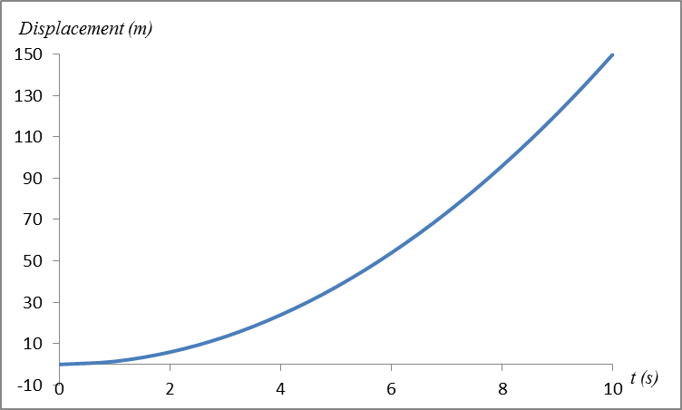
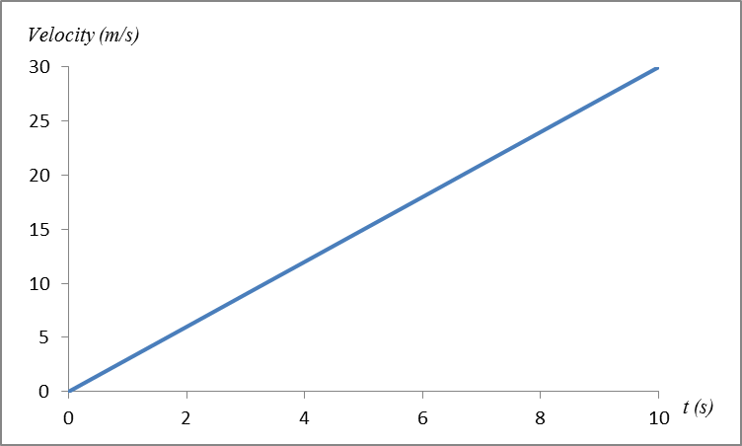
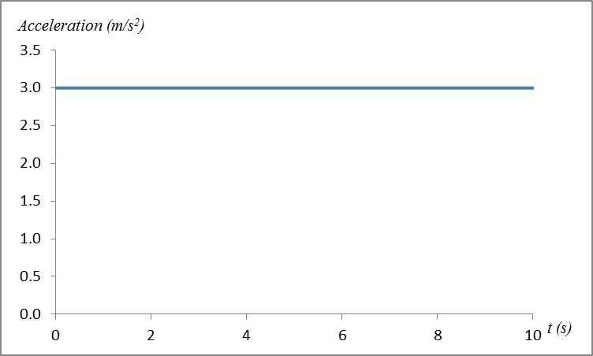
Velocity-Time Graph
Finding the area under the velocity-time curve to obtain the displacement-time curve
Finding the gradient of the velocity-time curve to obtain the acceleration-time curve

Slide 14
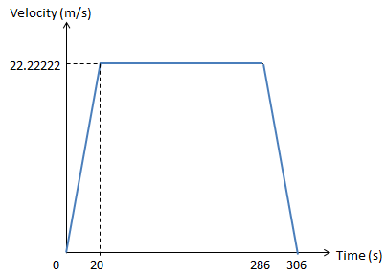
Displacement
In a Velocity-Time graph, the displacement can be obtained by finding the area under the graph.
In the example below, the displacement for 306 s can be calculated as follows.

Slide 15
Acceleration
In a Velocity-Time graph, the acceleration can be obtained by computing the gradient of the graph.
In the example below, the acceleration in the first 20 s can be calculated as follows.

Slide 16
Average Velocity vs Instantaneous Velocity
In the example below, the average velocity of the train travelling between 2 stations are calculated as follows.
The train is not travelling at the same velocity throughout the 306 seconds.
Hence, the instantaneous velocity is different at any given instant in time.

Slide 17
Applying to today’s problem
Some of the considerations that you need to consider when shortlisting the service provider(s) include:
Safety: The maximum velocity of the train at any time should not exceed 80 km/h.
Maximum Velocity ≤ 22.22 m/s
Comfort: The train cannot have a sudden acceleration or deceleration of more than 1 m/s² when moving away or towards a station.
Acceleration or Deceleration ≤ 1 m/s²
Consistency: The average velocity of the train between each station should not differ by more than 1.5 m/s.
Difference between Average Velocity ≤ 1.5 m/s
Additional consideration includes providing appropriate duration for passengers to get on and off the train at each station.

Slide 18
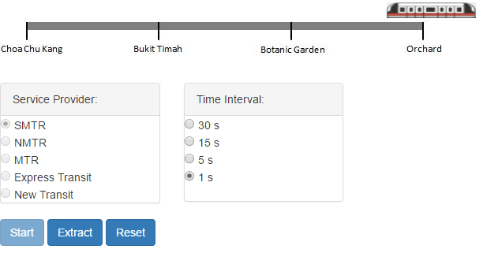
Applying to today’s problem
The most appropriate and available time interval to use for obtaining data from the Train Movement program would be 1 second.
We can use the graphs extracted at 1 second intervals to compute instantaneous velocity, acceleration, displacement and average velocity.

Slide 19
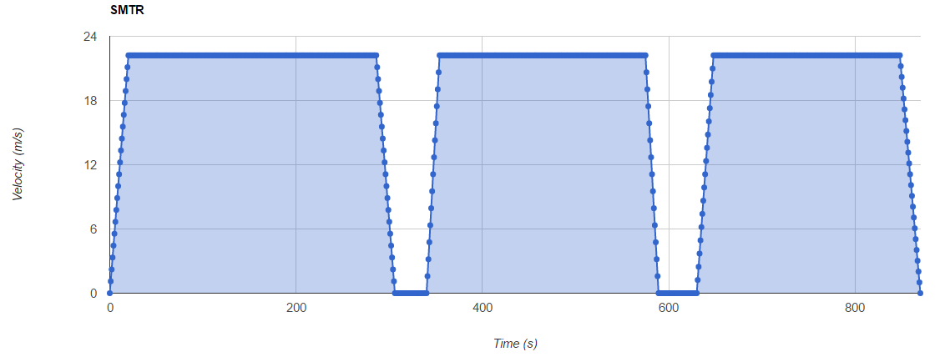
Applying to today’s problem
SMTR
20.77 m/s
20.97 m/s
20.37 m/s
22.22 m/s
1.11 m/s²
1.59 m/s²
1.23 m/s²
-1.11 m/s²
-1.59 m/s²
-1.01 m/s²
Maximum Velocity ≤ 22.22 m/s ✓
Acceleration or Deceleration ≤ 1 m/s² ✗
Difference between Average Velocity ≤ 1.5 m/s ✓

Slide 20
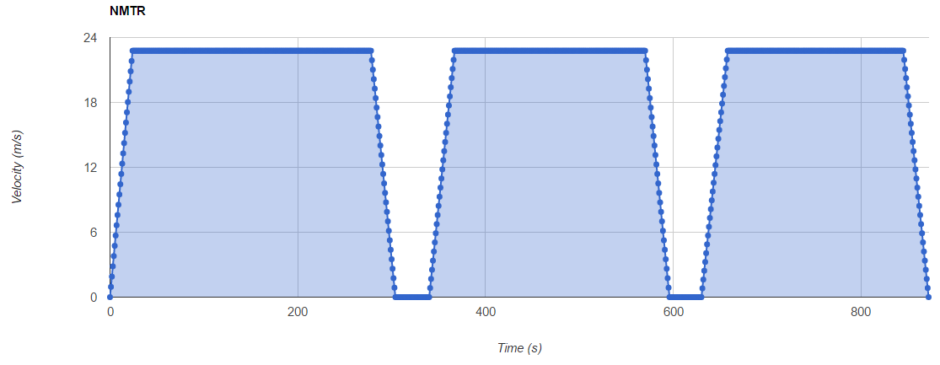
Applying to today’s problem
NMTR
20.90 m/s
20.42 m/s
20.19 m/s
22.78 m/s
0.95 m/s²
0.84 m/s²
0.81 m/s²
-0.88 m/s²
-0.88 m/s²
-0.84 m/s²
Maximum Velocity ≤ 22.22 m/s ✗
Acceleration or Deceleration ≤ 1 m/s² ✓
Difference between Average Velocity ≤ 1.5 m/s ✓

Slide 21
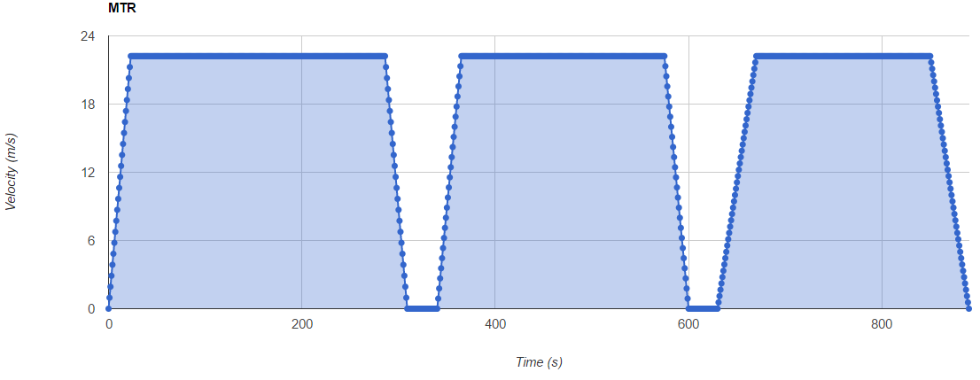
Applying to today’s problem
MTR
20.57 m/s
20.09 m/s
18.80 m/s
22.22 m/s
0.97 m/s²
0.89 m/s²
0.56 m/s²
-0.97 m/s²
-0.89 m/s²
-0.56 m/s²
Maximum Velocity ≤ 22.22 m/s ✓
Acceleration or Deceleration ≤ 1 m/s² ✓
Difference between Average Velocity ≤ 1.5 m/s ✗

Slide 22
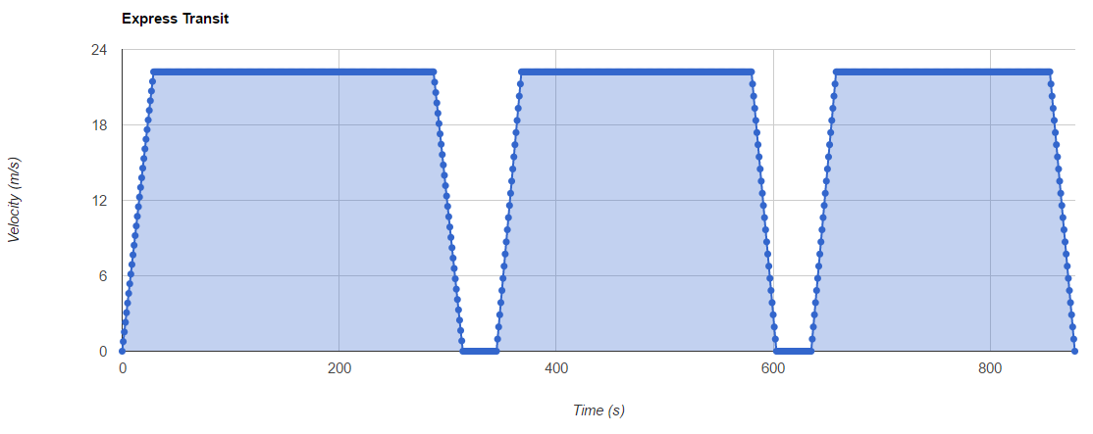
Applying to today’s problem
Express Transit
20.24 m/s
20.24 m/s
20.12 m/s
22.22 m/s
0.77 m/s²
0.97 m/s²
0.97 m/s²
-0.82 m/s²
-0.97 m/s²
-0.97 m/s²
Maximum Velocity ≤ 22.22 m/s ✓
Acceleration or Deceleration ≤ 1 m/s² ✓
Difference between Average Velocity ≤ 1.5 m/s ✓

Slide 23
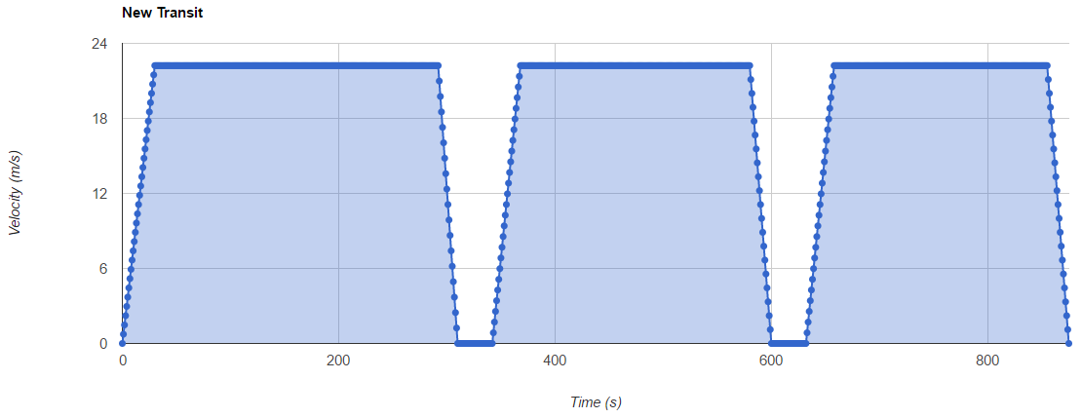
Applying to today’s problem
New Transit
20.50 m/s
20.24 m/s
20.12 m/s
22.22 m/s
0.74 m/s²
0.85 m/s²
0.85 m/s²
-1.23 m/s²
-1.11 m/s²
-1.11 m/s²
Maximum Velocity ≤ 22.22 m/s ✓
Acceleration or Deceleration ≤ 1 m/s² ✗
Difference between Average Velocity ≤ 1.5 m/s ✓

Slide 24
Worked Example (Practice Question Q2)
A car travels at a constant velocity of 120 km/h for 15 minutes, stopped for 15 minutes and continues in the same direction at a constant velocity of 80 km/h for 30 minutes. Assuming the car is travelling on a straight line,
calculate
the displacement in the first 30 minutes.
the average velocity for the entire 60 minutes.
a) For the first 15 minutes at a velocity of 120 km/h,
60 minutes 120 km
15 minutes
Since the next 15 minutes was at rest, the displacement in the first 30 minutes is 30 km.

Slide 25
Worked Example (Practice Question Q2)
b) For the last 30 minutes, at a velocity of 80 km/h,
60 minutes 80 km
30 minutes
Displacement = 70 - 0 = 70 km
Time = 60 min = 1 h

Slide 26
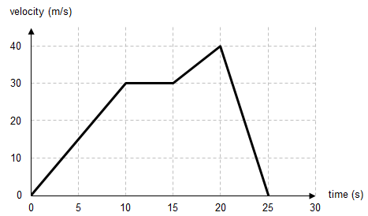
Worked Example (Practice Question Q6)
[Assumption: The object is travelling on a straight line.]
What is the instantaneous velocity of the object at t = 2 s?
What is the acceleration of the object at t = 12 s?
What is the acceleration of the object at t = 23 s?
What is the displacement of the object from time t = 0 to t = 20 s?
a) Instantaneous velocity at t = 2 s
6
2

Slide 27
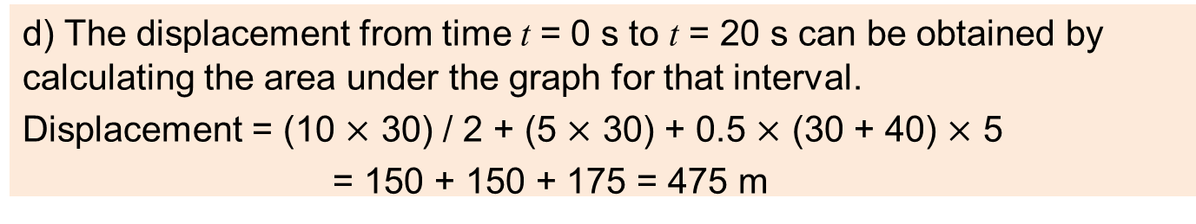
Worked Example (Practice Question Q6)
b) Acceleration at t = 12 s, is 0 m/s²
The vehicle is travelling at a constant velocity of 30 m/s, hence its acceleration is 0 m/s²
c) The gradient between t = 20 s and t = 25 s is calculated to obtain the acceleration at t = 23 s.
Acceleration at t = 23 s:
d) The displacement from time t = 0 s to t = 20 s can be obtained by calculating the area under the graph for that interval.
Displacement = (10 $×$ 30) / 2 + (5 $×$ 30) + 0.5 $×$ (30 + 40) $×$ 5
= 150 + 150 + 175 = 475 m

Slide 28
Learning Objectives
Determine distance travelled, speed and rate of change of speed.
Determine displacement, velocity and acceleration.
Interpret distance-time and speed-time graphs.
Interpret displacement-time and velocity-time graphs.
Distinguish between average and instantaneous rate of change.
Explain the differences between zero, constant, increasing or decreasing rate of change in different situations.
Explain how the quantity-time graph can be used to obtain the rate of change graph, and vice versa.

Slide 29
Exploring Further
The rate of change at a particular instance is known as the instantaneous rate of change, which can vary at different points in time.
For a velocity-time graph, the gradient of the tangent line at any particular time represents the instantaneous acceleration at that point in time.
Velocity (m/s)
Gradient
0
30
Time (s)

Slide 30
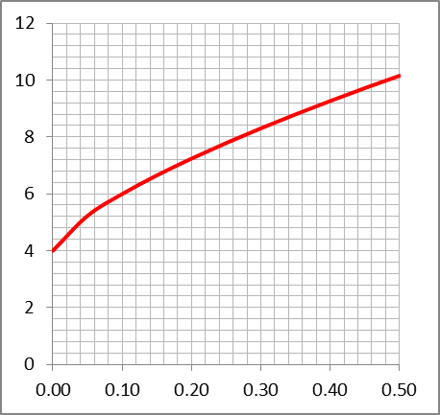
Exploring Further
One way in which we can estimate the instantaneous acceleration at a point is by draw tangent at the given point and use it to estimate the gradient as shown below.
Velocity
Instantaneous acceleration at t = 0.20 s
Time, t

Slide 31
Exploring Further
The calculations using data at smaller intervals would improve the accuracy of the estimation of instantaneous acceleration, i.e. the estimates obtained will be closer to the actual instantaneous acceleration.
Velocity
Velocity
Time Interval of 0.40 s
Time, t
Time Interval of 0.04 s
Time, t

Slide 32
Exploring Further
Given a rate of change of quantity versus time graph, the area under the graph will represent the total amount of quantity.
For constant velocity,
Total displacement = Velocity × Time taken
= Area under the graph
Velocity
Area under the graph gives the total displacement from time t₁ to time t₂
Time, t
0
t₁
t₂

Slide 33
Exploring Further
For a curve with the rate of change of quantity that changes with time (i.e. it is not constant), we can estimate the total amount of quantity within the given time period by finding the area under the graph.
This can be done by:
dividing the time period into small time intervals,
finding the area for each time interval by assuming that the velocity is constant during that interval, and
summing up the area for all the intervals.
f(t)
Velocity
The sum of the areas of the rectangles under the graph gives the estimated total displacement from time 0 to time t₇
0
t₁
t₂
t₃
t₄
t₅
t₆
t₇
Time, t

Slide 34
Exploring Further
Depending on the graph, the estimated area under the graph can be smaller or larger than the actual area.
Velocity
Velocity
f(t)
f(t)
0
t₁
t₂
t₃
t₄
t₅
t₆
t₇
0
t₁
t₂
t₃
t₄
t₅
t₆
t₇
Time, t
Time, t
The estimated area under the graph is smaller than the actual area.
The estimated area under the graph is larger than the actual area.

Slide 35
Exploring Further
As we estimate the total displacement using smaller and smaller time intervals, the estimation converges towards the exact area.
Velocity
Velocity
f(t)
f(t)
Smaller time intervals
0
t₁
t₂
t₃
t₄
0
t₁
t₂
t₃
t₄
t₅
t₆
t₇
t₈

Slide 36
Infinitely small intervals
When we reduce the time interval into an infinitely small time interval, we will eventually get the exact area under the graph.
Velocity
f(t)
0
t₁
Time, t
This process is known as integration.

